Slide 1
Employee Data Analysis using Excel
STUDENT NAME:GOPIKA R
REGISTER NO:312211229/B184321B3B3C27D9DD04CC9A988CED2E
DEPARTMENT: B. COM GENERAL (COMMERCE)
COLLEGE: DR.M.G.R.JANAKI OF ARTS AND SCIENCE FOR WOMEN.

Slide 2
PROJECT TITLE
Employee Performance Analysis using Excel

Slide 3


AGENDA
Problem Statement
Project Overview
End Users
Our Solution and Proposition
Dataset Description
Modelling Approach
Results and Discussion
Conclusion
3/21/2024 Annual Review

Slide 4

PROBLEM STATEMENT
*Traditional methods of assessing employee performance lack consistency and fail to
provide actionable insights for organizational growth.
*This leads to inefficiencies in resource allocation and missed opportunities for improving
productivity and employee satisfaction.
*By implementing a robust performance analysis framework using Excel, we aim to establish
standardized metrics and comprehensive data analysis capabilities.
*This initiative seeks to empower decision-makers with accurate insights to optimize
performance, foster a culture of continuous improvement, and ultimately drive
organizational success.

Slide 5

PROJECT OVERVIEW
Employee analysis the performance of the employee by consider various factors likeGender, performance score, rating achievement Performance analysis involves the systematic evaluation of employee productivity, efficiency, and effectiveness within an organization. By analyzing key metrics such as task completion rates, sales figures, customer satisfaction scores, and other relevant data, organizations can gain insights into individual and team performance. This process helps identify strengths, weaknesses, and areas for improvement, enabling informed decision-making and targeted interventions to enhance overall organizational performance.
.

Slide 6


WHO ARE THE END USERS?
EMPLOYEES
EMPLOYERS
ORGANISATION
INDUSTRIES

Slide 7
OUR SOLUTION AND ITS VALUE PROPOSITION
FORMULA -PERFORMANCE
PIVOT -SUMMARY
GRAPHIC-DATA VISUALISATION
CHART.

Slide 8
Dataset Description
EMPLOYEE- KAGGLE
26- FEATURES
10- FEATURES
EMPLOYEE ID
FIRST NAME
LAST NAME
BUSINESS UNIT
EMPLOYEE STATUS
EMPLOYEE TYPE
EMPLOYEE CLASSIFICATION TYPE
GENDER
PERFORMANCE SCORE
CURRENT EMPLOYEE RATING

Slide 9

THE "WOW" IN OUR SOLUTION
*Performance level=IFS(J2>=5, "VERYHIGH",J2>=4, " HIGH", J2>=3,
" MED","TRUE", "LOW“)
‹#›

Slide 10
MODELLING
DATA COLLECTION
1) kaggle-employee
2) login
3) Employees Data collect
FEATURES COLLECTION
1) 26-Features
2) Select 10-features
* Employee ID
* First name
* Last name
* Business unit
* Employee status
* Employee type
* Employee classification type
* Gender
* Performance score
* Current employee rating
* Performance analysis value
‹#›

Slide 11
DATA CLEANING
1)Select filter option
2)Insert colour
3)Select no file
PERFORMANCE LEVEL
1)Value of j2
2)=IFS(J2.=5,”VERY HIGH”,J2.=4,”HIGH”,J2.=3,”MED”,”TRUE”,’LOW”)
SUMMARY
1)Auto file
2)Graphs & chart
3)Collect data & analysis
VISUALIZATION
1)Dashboard creation
2)Conditional formatting
3)Pivot tables
4)Trend analysis

Slide 12
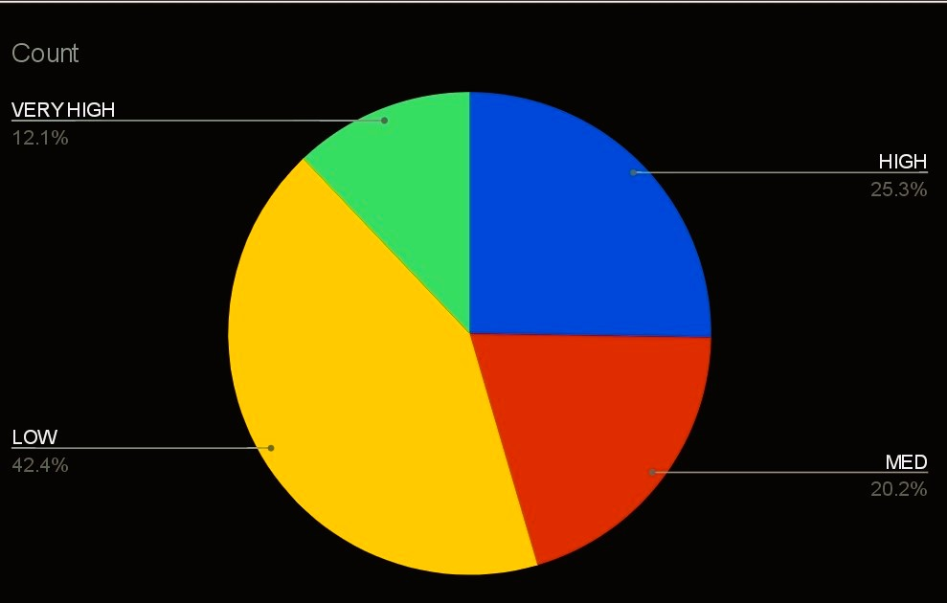
RESULTS
‹#›

Slide 13
conclusion
This distribution provides a comprehensive overview of how employees are performing across different levels, highlighting areas of strength and areas needing improvement within the organization.
And motivated the low performance employee because they high members of the data so motivated the low performance employee

